Slide 1

SafeOregon

Slide 2

Learning Objectives (HS)
Understand the SafeOregon program.
1
Analyze risk factors and signs of dangerous actions and behaviors.
2
Learn where to go for help and how to report concerning actions and behaviors.
3
Evaluate and learn tips for staying safe online.
4
Advocate for safe school communities.
5
HS.SEM.6 Describe the signs and symptoms of mental health challenges, including the warning signs of suicide, self-harm, eating disorders and disordered eating, and other unsafe behaviors.
HS.SFA.7 Evaluate strategies for using social media safely, legally, and respectfully.
HS.HRVP.9 Model how to be an upstander by addressing hurtful comments, addressing concepts of intent, impact, and repair.
HS.SEM.8 Advocate for safer school communities to prevent bullying and violence and improve mental health.

Slide 3
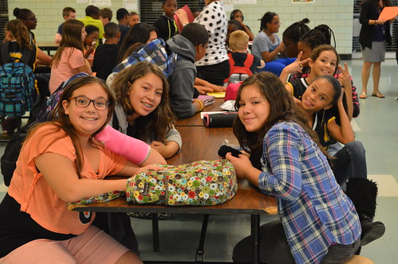
Learning Objectives (MS)
Understand the SafeOregon program.
1
Analyze risk factors and signs of dangerous actions and behaviors.
2
Learn where to go for help and how to report concerning actions and behaviors.
3
Evaluate and learn tips for staying safe online.
4
Advocate for safe school communities.
5
7.SEM.3 Identify and discuss causes, symptoms, and impacts of depression, anxiety, including eating disorders and disordered eating, trauma, self-harm, and suicide.
8.SFA.4 Work cooperatively to create projects that advocate for practices that promote safe and accessible communities.
8.SEM.4 Recognize when professional services are needed for self and others experiencing chronic or serious mental health concerns and traumatic stress, including self-harm, eating disorders and disordered eating, substance use and abuse, and suicidal ideation.

Slide 4

Disclaimer
During this lesson, we will be discussing sensitive topics like violence, self harm, bullying, and drug and alcohol abuse.
While these topics may be uncomfortable to talk about, it is necessary for our safety and wellbeing as a community.
If you need a break or would like to talk to someone during or after the lesson, please let someone know.

Slide 5

Warm Up
Why wouldn’t someone speak up when they see another person who needs help? (i.e., engaging in risky behavior, self harming, abusing drugs or alcohol, etc.)
Can you think of a time when you wish someone would have helped you or a friend?

Slide 6

Important Vocabulary
Bullying- repetitive, intentional hurting of one person or group by another person or group, where the relationship involves an imbalance of power. Can happen in person, or online (cyberbullying).
Suicide- the act or an instance of ending one's own life voluntarily and intentionally.
Suicidal Ideation- think about, consider or feel preoccupied with the idea of death and suicide.
Self harm- when a person hurts their own body on purpose.
Gun violence- violence against a person committed with the use of a firearm which includes homicide, violent crime, attempted suicide, suicide, and unintentional death and injury.
School violence- violent acts that disrupt learning and have a negative effect on students, schools, and the broader community.
Notes:
For the State of Oregon’s official definition of some of this words- please visit ORS 339.341 – Statewide School Safety and Prevention System

Slide 7

What is SafeOregon?
A place to report safety concerns directly to your school - confidentially or anonymously.
Examples of what can be reported to SafeOregon:
  Bullying and harassment (online and/or in-person).
  Threats of violence against people.
  Threats of violence against schools.
  Drug and alcohol abuse.
  Self harm or self-destructive behavior.
  Sexual violence and/or sexual assault.

Slide 8

How Does SafeOregon Work?
Information is submitted by email, phone, text, a mobile app or a web portal.
All tips are received by a live person at a call center, 24 hours a day, 7 days a week (even on holidays and during school breaks).
Tips are quickly forwarded to a few specially selected school personnel.
If the situation is very serious and needs outside immediate assistance, school personnel and/or the call center may contact the local police.
Notes:
SafeOregon is a tip line with a goal to prevent school safety threats and help make schools safer.
The tip line is a tool to report potential threats against students and schools in a confidential or anonymous way.
Tips can be submitting through an email, a phone call, text, a mobile app or a web portal.
All tips go immediately to a tip line technician 24×7.
Tips are quickly analyzed and forwarded to designated school personnel (and law enforcement when necessary) to provide further assistance in resolving reported incidents.

Slide 9

What SafeOregon ISN’T:
A place to complain that you don’t like your teacher.
A place to report about how cold/hot your classroom is.
A place to complain about how much homework you are assigned.
A good thing to keep in mind when deciding whether to use SafeOregon to report something is the word Safe. If something is making you feel unsafe at school or your worried about a friend or classmates' safety, it is definitely something you should report.

Slide 10

Recognize the Signs of Danger
Talking about suicide/wanting to die or disappear.
Talking about violence against others or the school.
Talking, writing, or drawing about death and/or killing.
Giving away belongings.
Withdrawing from friends and family.
Being angry, hostile, hopeless, anxious, and/or depressed.
Doing risky things, like driving too fast.
Using alcohol and drugs.
Changes in eating and sleeping patterns.

Slide 11

How Many Signs Do You See?
Lena is a 7th-grade student who used to be very active in school clubs and loved hanging out with friends. Over the past few weeks, Lena has started skipping club meetings, not turning in homework, and avoiding eye contact with teachers and classmates. She’s also been wearing long sleeves every day, even when it’s hot out.
Some students have noticed Lena hanging out with an older student after school, someone known for getting into trouble. One day in class, a classmate named Mia sees a concerning message pop up on Lena’s tablet from a friend that says, “Did you take it again today? Don’t let anyone find out.”
Mia doesn’t know what it means, but combined with everything else, it makes her nervous.
Notes:
Potential Discussion Questions:
What are some signs that Lena might be struggling or taking risks?
What do you think the message on her tablet could mean?
How could Mia respond in a way that is safe and helpful?
Why is it important to notice changes in behavior—even small ones?
What adults at school could Mia talk to for help?
How could a resource like SafeOregon be used in this situation?

Slide 12
Take it Seriously. Act Immediately.
TAKE IT SERIOUSLY.
Take every threat or disclosure seriously. They are often a cry for help.
1
ACT IMMEDIATELY.
Be an upstander rather than a bystander. Make the choice to intervene.
2
GET HELP.
Tell a trusted adult or use the SafeOregon tip line. Others don’t have to know you reported it.
3
Notes:
Often times, disclosures are a cry for help and people want to be stopped. Around 60% of the time, individuals will tell at least one other person about their plan.
An upstander is someone who witnesses a behavior that could lead to something high risk or harmful and makes the choice to intervene to make things better.
Tipline is there to intervene and investigate…. If you are unsure if a threat is serious or not, report it anyway, and SAFEOregon will confirm or deny if it is an actual threat.

Slide 13

Online Safety
If you are the victim or witness of cyberbulling or you see something unsafe or scary online….
Report It! Don’t Repost It!

Slide 14

Talking to a Trusted Adult
When you need support or advice.
When you encounter and issue or problem that you need guidance or support with.
If you’re being bullied, harassed, or in emotional distress and need someone to talk to.
When you’re making important decisions and need guidance to find a solution.
If you feel unsafe or at risk in any situation.
Who is your trusted adult?
Mom? Dad? Grandparent? Older Cousin? Neighbor? Teacher? Coach?

Slide 15

Code of Silence
Code of Silence: “An unwritten rule where individuals – often in a group - choose not to report or speak out about dangerous, harmful, or wrong behaviors, often due to fear of being labeled a snitch, losing friends, or facing peer pressure.”
Don’t let the Code of Silence get in the way of helping someone.
Tattling: To get someone IN trouble for an action or behavior that is harmless, unimportant, or an accident.
Telling: To get someone OUT of trouble for an action or behavior that is concerning, harmful, or dangerous.
Reporting serious issues like bullying, threats, or safety concerns is never tattling.
It’s also important to keep in mind that SafeOregon can be entirely and completely anonymous!

Slide 16

How Can You Help?
1. You notice a new student is being made fun of frequently by a group of kids in the lunchroom. Today, you see the student take their lunch to the bathroom. You think its so they don’t have to be around the kids that are bullying them.
2. You are scrolling online and see a classmate’s online post was turned into a hurtful meme using their name and picture. The next day at school, students are teasing them about it.
Notes:
Often times, disclosures are a cry for help and people want to be stopped. Around 60% of the time, individuals will tell at least one other person about their plan.
An upstander is someone who witnesses a behavior that could lead to something high risk or harmful and makes the choice to intervene to make things better.
Tipline is there to intervene and investigate…. If you are unsure if a threat is serious or not, report it anyway, and SAFEOregon will confirm or deny if it is an actual threat.

Slide 17

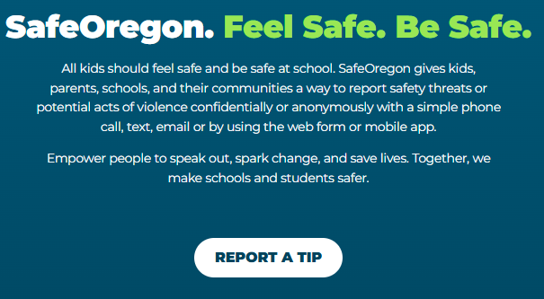
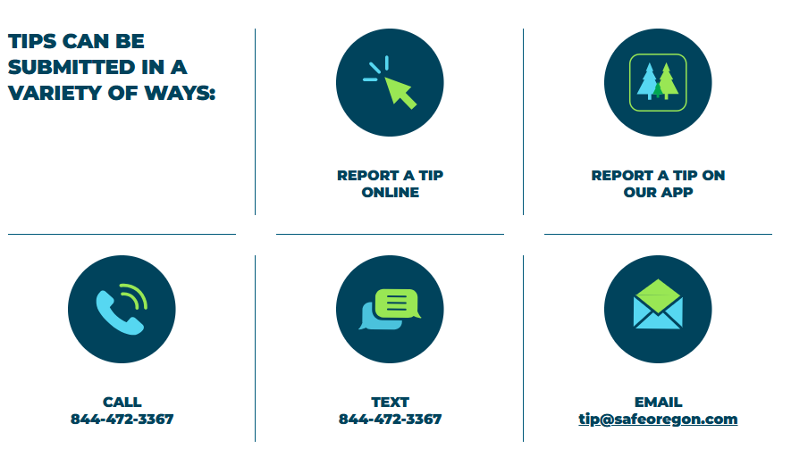
Submitting a Tip Through SafeOregon
The tipline is available 24 hours a day, 7 days a week. Even during holidays.
A real, live person is on the other end to receive the information.
All information goes directly back to your school (and/or law enforcement if needed) so they can determine the best action.

Slide 18
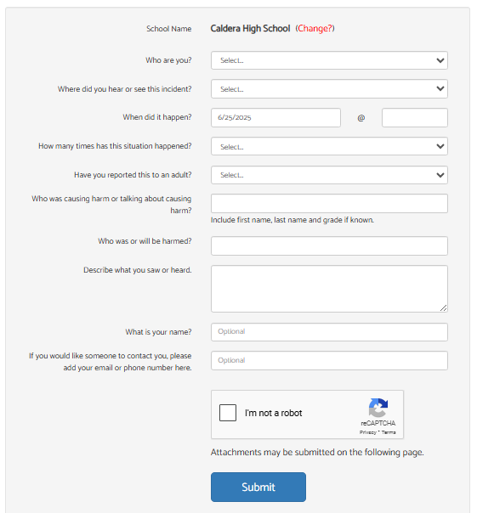
Using the SafeOregon Webform
Make sure your school is listed in this box!
Give as much detail as possible here, especially if you are not leaving your name or contact info!
Even if you decide to include your name, the school will keep it confidential.
Include screenshots, photos, or short videos if you have them.

Slide 19

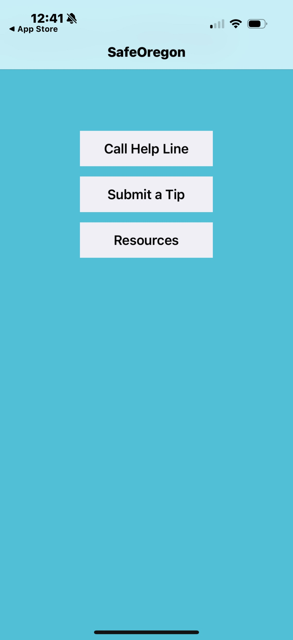
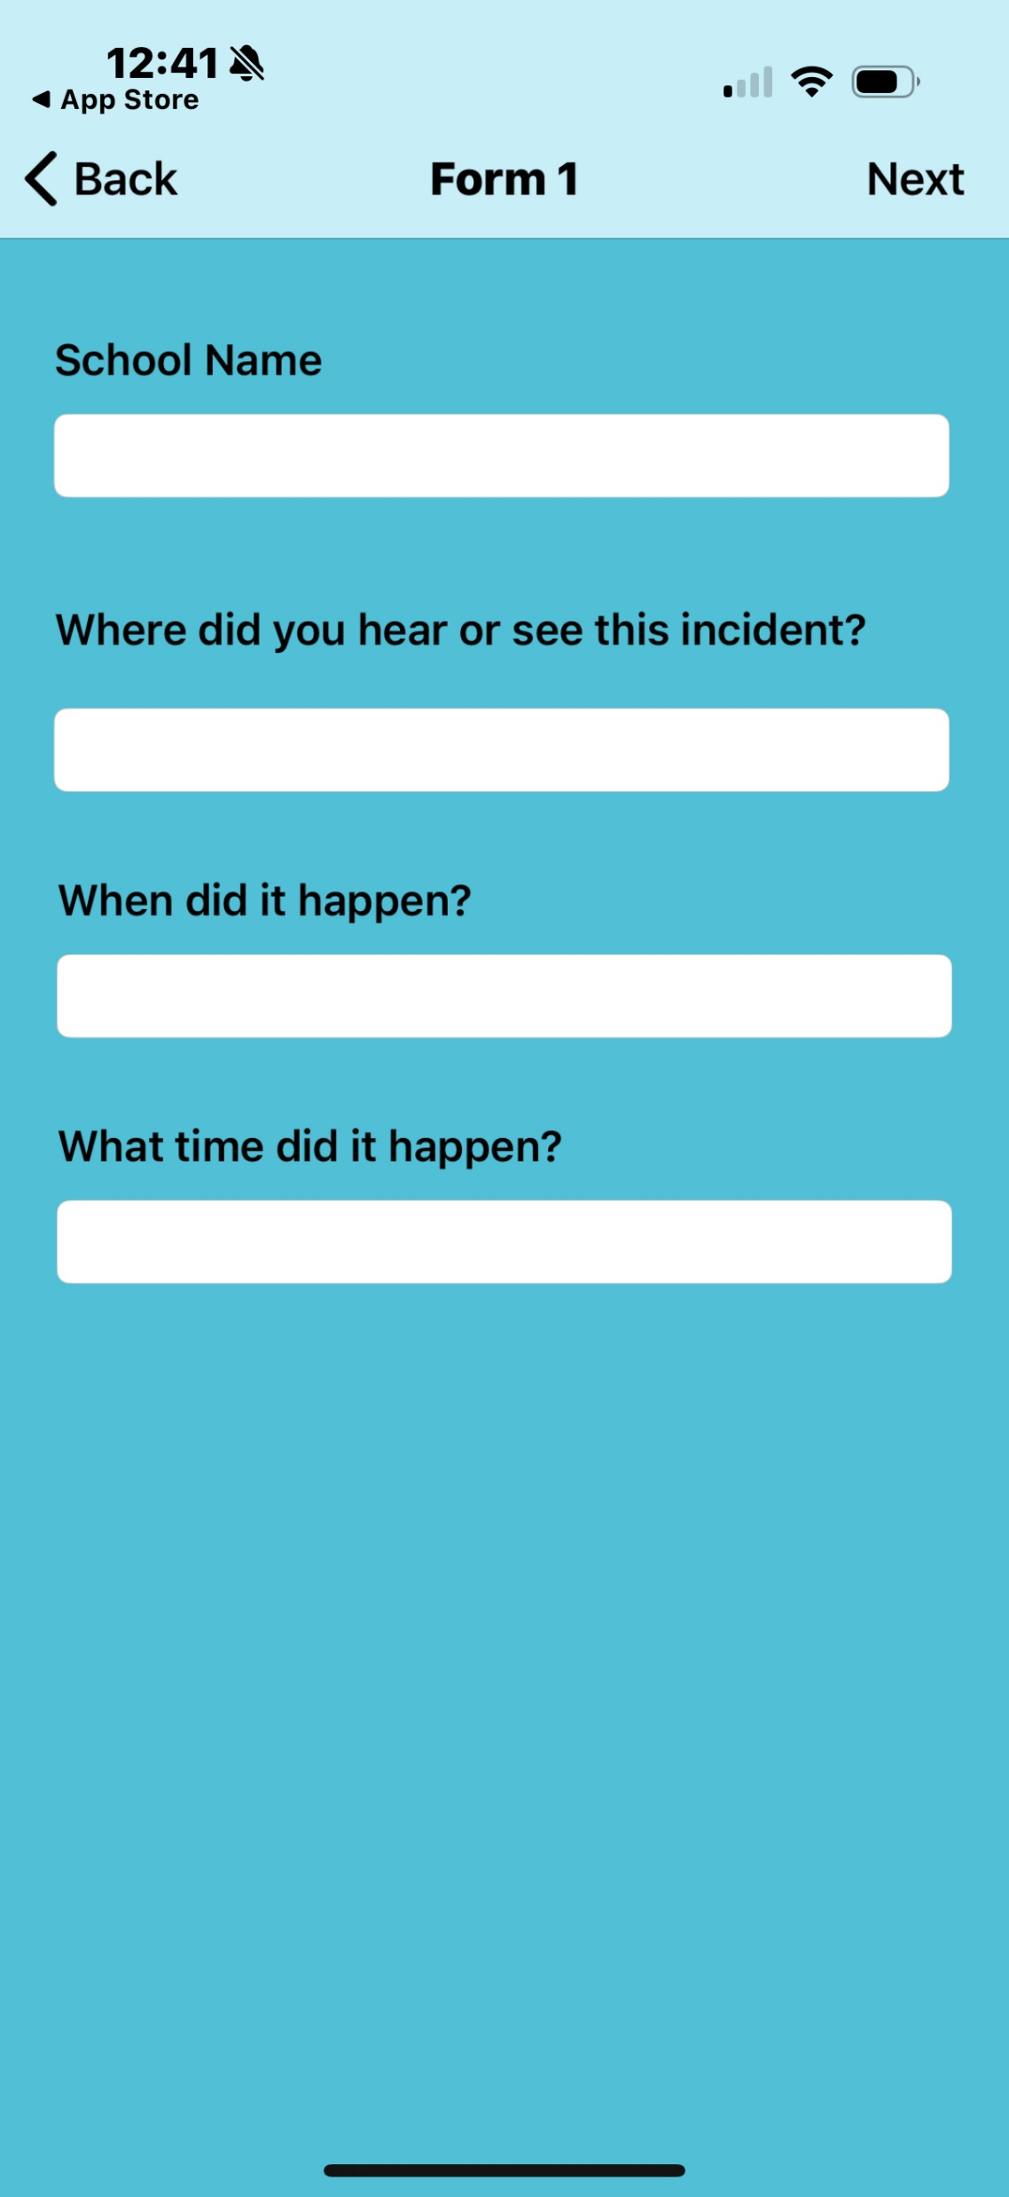
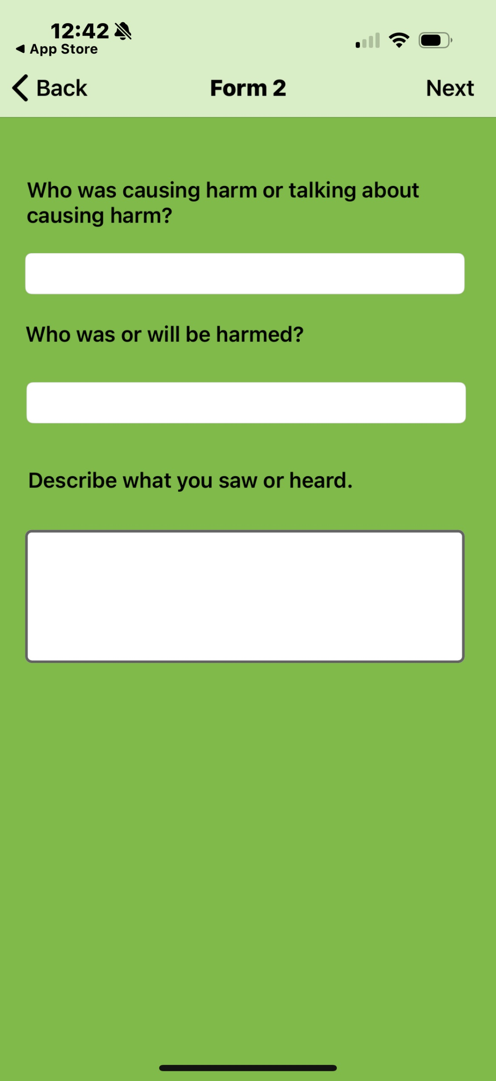
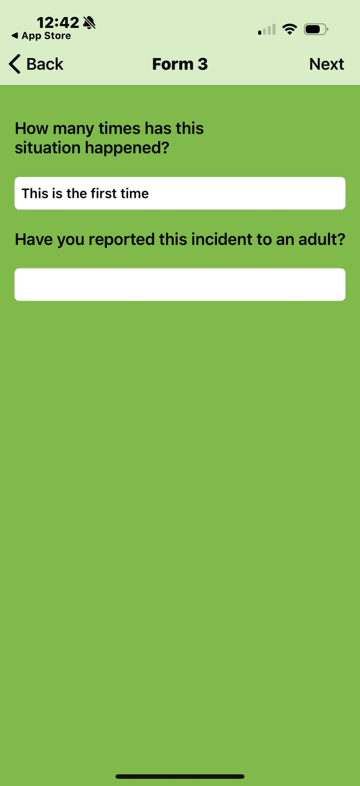
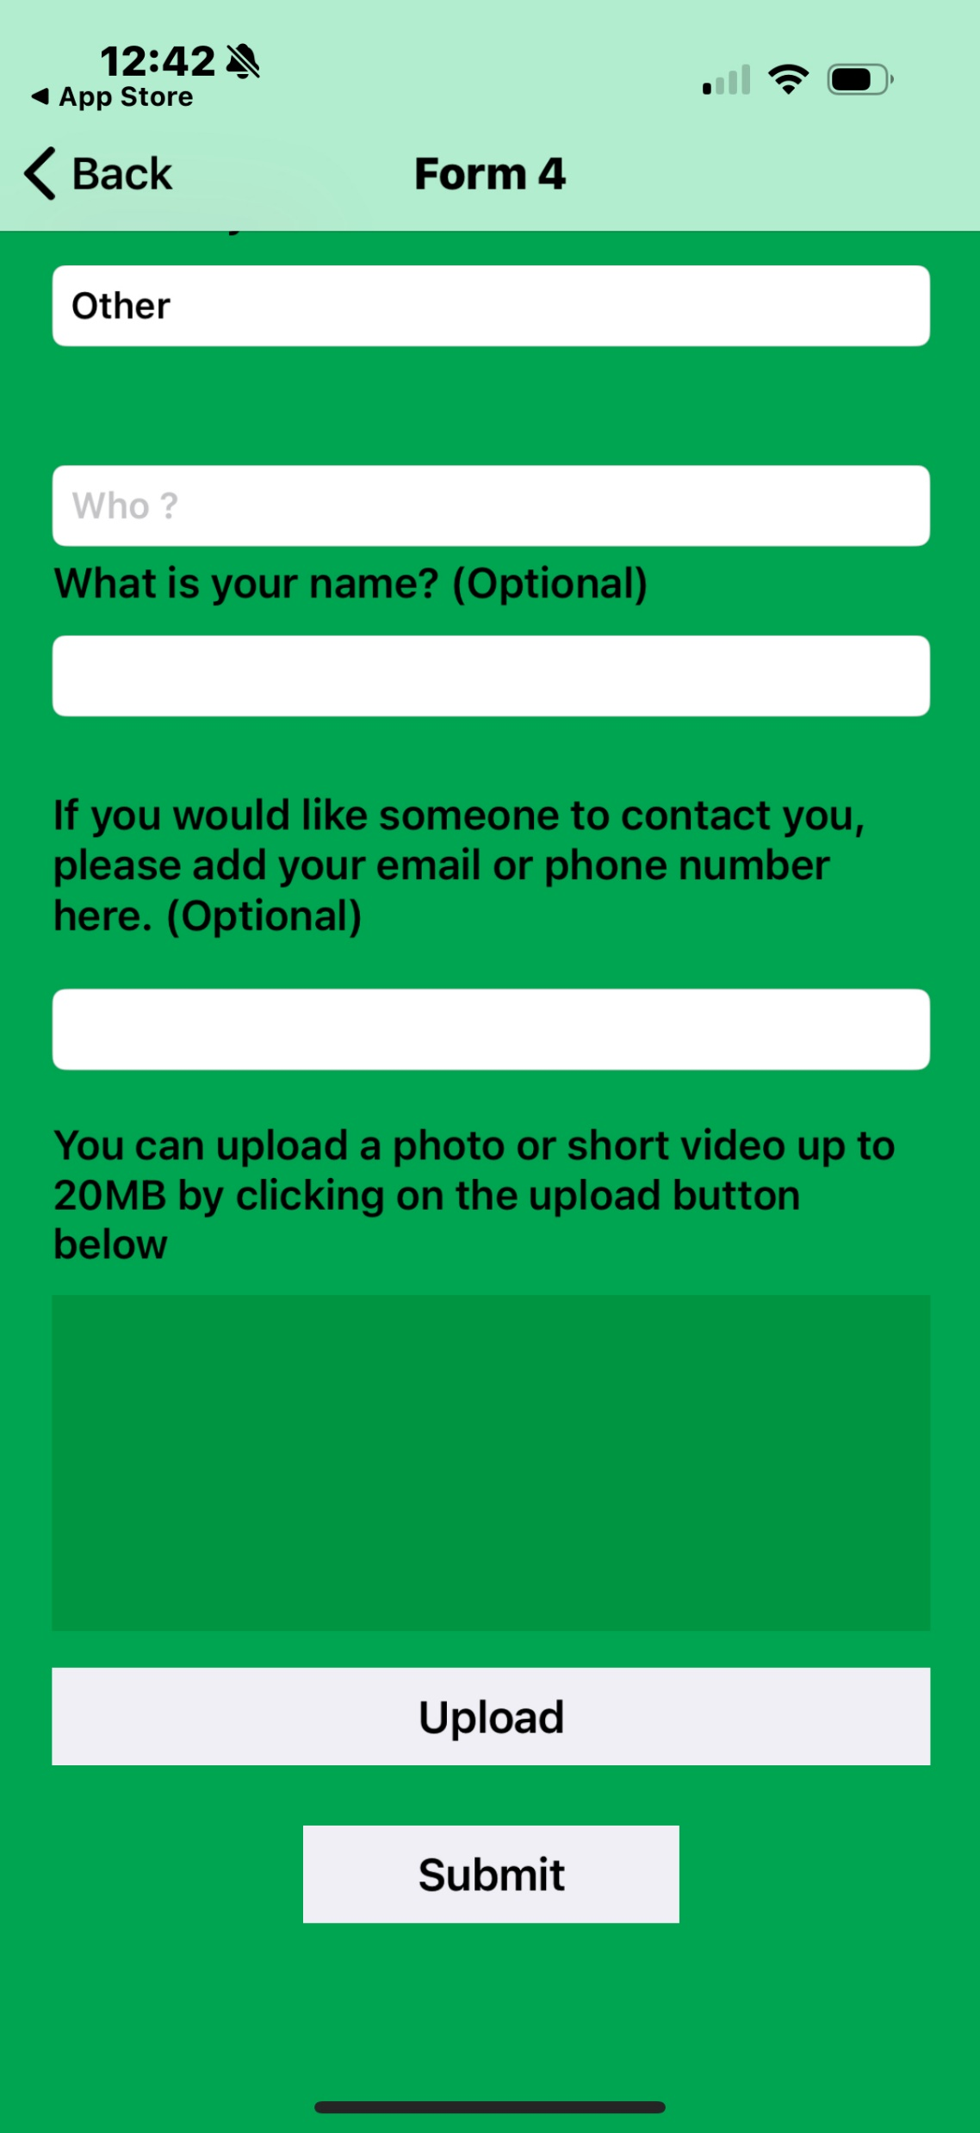
Using the SafeOregon Mobile App

Slide 20




Additional Resources
988 Suicide and Crisis Lifeline Available 24 hours a day
  Call/Text 9-8-8 | Online chat available at https://chat.988lifeline.org/
Youthline Available 4-10 p.m. daily
  Call 877.968.8491 | Text ‘teen2teen’ to 839863 | Email teen2teen@linesforlife.org
  Free, confidential teen-to-teen crisis and help line. No problem is too big or too small
Bias Response Hotline Available Monday-Friday from 9 a.m.-5 p.m.
  Call 1-844-924-BIAS (2427) | Online reporting form at https://justice.oregon.gov/CrimeReporting/
  Confidential, non-emergency hotline to report hate crimes, bias incidents, or any targeting based on protected class (race, color, national origin, sexual orientation, gender identity, religion, disability)
  Will help with support, next step options, and reporting to police if you choose
The Trevor Project Available 24 hours a day
  Call 866-488-7386 | Text ‘START’ to 678-678 | Online chat available at https://www.thetrevorproject.org/get-help/
  Confidential suicide hotline for LGBTQ youth
Take it Down Available 24 hours a day, Visit https://takeitdown.ncmec.org/
  Free service to help remove online nude, partially nude, or sexually explicit photos and videos taken before age 18.
  CyberTipline to report child sexual exploitation if you or someone you know is a victim. 1-800-THE-LOST | https://report.cybertip.org/

Slide 21
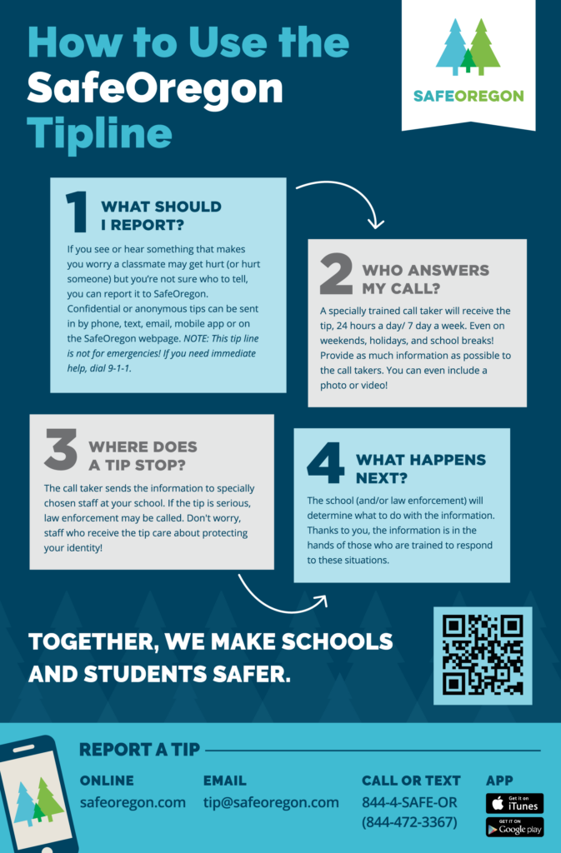
Poster Activity
To advocate for the program and use of SafeOregon at your school, please create a poster to advertise SafeOregon to your classmates.
Your poster should include:
  A slogan for your poster
  ‘SafeOregon’ logo prominently displayed
  3-4 Tips for using SafeOregon
  An example of when to use SafeOregon

Slide 22
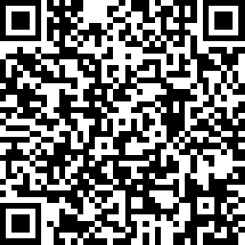
Exit Ticket
1. Take the Student Survey (four options)
  Scan the QR code
  On the Web: https://www.surveymonkey.com/r/6T8RMMK
  Google Forms: https://forms.gle/gketWKcfYeAy6Va46
  Fill out the paper survey
2. Download the SafeOregon App

