Slide 1



SAFEOREGON

Slide 2




Learning Objectives (HS)
1
Understand the SafeOregon program.
2
Analyze risk factors and signs of dangerous actions and behaviors.
HS.SEM.6 Describe the signs and symptoms of mental health challenges, including the warning signs of suicide, self-harm, eating disorders and disordered eating, and other unsafe behaviors.
3
Learn where to go for help and how to report concerning actions and behaviors.
4
Evaluate and learn tips for staying safe online.
HS.SFA.7 Evaluate strategies for using social media safely, legally, and respectfully.
HS.HRVP.9 Model how to be an upstander by addressing hurtful comments, addressing concepts of intent, impact, and repair.
Advocate for safe school communities.
5
HS.SEM.8 Advocate for safer school communities to prevent bullying and violence and improve mental health.

Slide 3
Learning Objectives (MS)
Understand the SafeOregon program.
1
2
Analyze risk factors and signs of dangerous actions and behaviors.
7.SEM.3 Identify and discuss causes, symptoms, and impacts of depression, anxiety, including eating disorders and disordered eating, trauma, self-harm, and suicide.
3
Learn where to go for help and how to report concerning actions and behaviors.
4
Evaluate and learn tips for staying safe online.
8.SFA.4 Work cooperatively to create projects that advocate for practices that promote safe and accessible communities.
5
Advocate for safe school communities.
8.SEM.4 Recognize when professional services are needed for self and others experiencing chronic or serious mental health concerns and traumatic stress, including self-harm, eating disorders and disordered eating, substance use and abuse, and suicidal ideation.

Slide 4


DISCLAIMER
During this lesson, we will be discussing sensitive topics like violence, self harm, bullying, and drug and alcohol abuse.
While these topics may be uncomfortable to talk about, it is necessary for our safety and wellbeing as a community.
If you need a break or would like to talk to someone during or after the lesson, please let someone know.

Slide 5

WARM UP
Why wouldn't someone speak up when they see another person who needs help? (i.e., engaging in risky behavior, self harming, abusing drugs or alcohol, etc.)
Can you think of a time when you wish someone would have helped you or a friend?

Slide 6





Important Vocabulary
Repetitive, intentional hurting of one person or group by another person or group, where the relationship involves an imbalance of power. Can happen in person, or online (cyberbullying).
Bullying
The act or an instance of ending one's own life voluntarily and intentionally.
Suicide
Suicidal Ideation
Think about, consider or feel preoccupied with the idea of death and suicide.
Self-Harm
When a person hurts their own body on purpose.
Violence against a person committed with the use of a firearm which includes homicide, violent crime, attempted suicide, suicide, and unintentional death and injury.
Gun Violence
Violent acts that disrupt learning and have a negative effect on students, schools, and the broader community.
School Violence

Slide 7


What is SafeOregon?
A place to report safety concerns directly to your school - confidentially or anonymously.
Examples of what can be reported:
Bullying and harassment (online and/or in-person).
Threats of violence against people.
Threats of violence against schools.
Drug and alcohol abuse.
Self harm or self-destructive behavior.
Sexual violence and/or sexual assault.

Slide 8

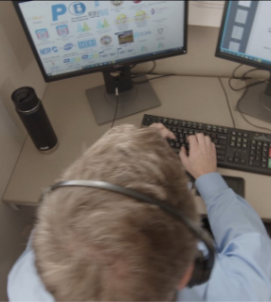
How Does SafeOregon Work?
Information is submitted by email, phone, text, a mobile app or a web portal.
All tips are received by a live person at a call center, 24 hours a day, 7 days a week (even on holidays and during school breaks).
Tips are quickly forwarded to a few specially selected school personnel.
If the situation is very serious and needs outside immediate assistance, school personnel and/or the call center may contact the local police.

Slide 9

What SafeOregon
ISN'T for:
Teacher complaints
Homework issues
Getting others in trouble
Lost property
Pranks/jokes
When using SafeOregon, think of the word 'Safe'. If something is making you feel unsafe at school or you are worried about a friend or classmates' safety, report it.

Slide 10









Recognize the Signs of Danger
Talking about suicide/wanting to disappear.
Talking about violence against others or the school.
Withdrawing from friends and family.
Giving away belongings.
Talking, writing, or drawing about death and/or killing.
Doing risky things, like driving too fast.
Using alcohol and/or drugs.
Being angry, hostile, hopeless, anxious, and/or depressed
Changes in eating or sleeping patterns

Slide 11

How Many Signs Do You See?
Lena, a 7th grader, has changed. Recently, she's skipping meetings, missing homework, avoiding friends, and wearing long sleeves in the heat. She's also hanging out with a troubled older student.
Lena's friend, Mia, saw a text on Lena’s phone: 'Did you take it again today? Don’t let anyone find out.' Mia is now very concerned.

Slide 12




Take it Seriously. Act Immediately.
Take It Seriously.
Act Immediately.
Get Help.
Take every threat or disclosure seriously. They are often a cry for help.
Be an upstander rather than a bystander. Make the choice to intervene.
Tell a trusted adult or use the SafeOregon tip line. Others don't have to know you reported it.

Slide 13

Online Safety
If you are the victim or witness of cyberbullying or you see something unsafe or scary online...
Report it! Don't repost it!

Slide 14

Talking to a Trusted Adult
When you need support or advice.
When you encounter an issue or problem that you need guidance or support with.
If you're being bullied, harassed, or in emotional distress and need someone to talk to.
When you're making important decisions and need guidance to find a solution.
If you feel unsafe or at risk in any situation.

Slide 15



Code of Silence
TATTLING: To get someone IN trouble for an action or behavior that is harmless, unimportant, or an accident.
An unwritten rule where people don't report harm due to fear of being called a snitch or peer pressure.
TELLING: To get someone OUT of trouble for an action or behavior that's concerning, harmful, or dangerous.
Reporting safety concerns is never tattling. SafeOregon can be completely anonymous.

Slide 16

How Can You Help?
You notice a student being bullied in the lunchroom every day. Today, the student is eating in the bathroom to avoid the group.
A classmate's post is turned into a hurtful meme. Students tease them about it at school the next day.

Slide 17

Submitting a Tip Through SafeOregon
Call
844-4-SAFE-OR
(844-472-3367)
Tipline is available 24 hours a day, 7 days a week. Even during holidays.
A real, live person is on the other end to receive information.
Information goes directly back to your school so they can determine the best action.
Text
844-4-SAFE-OR
(844-472-3367)
Email
tip@safeoregon.com
Mobile App
iPhone or Android
Online
www.safeoregon.com

Slide 18

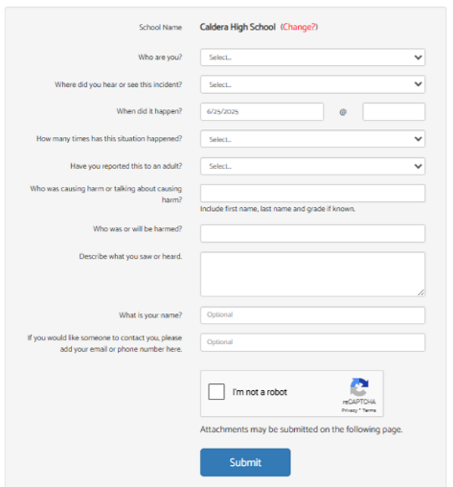
Using the SafeOregon Webform
Make sure your school is listed in this box.
Even if you decide to leave your name, the school will keep it confidential.
Give as much detail a possible, especially if you do not leave you name.
Include screenshots, photos, or short videos if you have them.

Slide 19

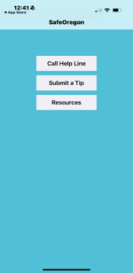
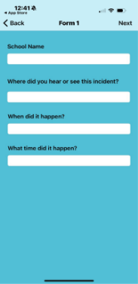
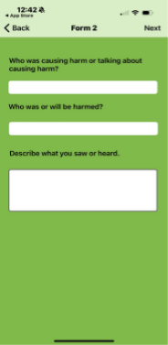
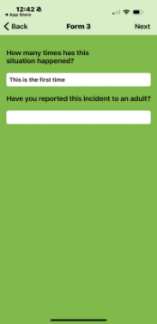
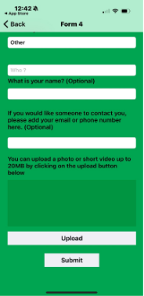
Using the SafeOregon Mobile App

Slide 20





Additional Resources
988 Suicide and Crisis Line
Available 24 hours a day
Call/text 9-8-8
Online chat available at https://chat.988lifeline.org/
Available 4-10 p.m. daily
Call 877-968-8491 | Text 'teen2teen' to 839863 | email teen2teen@linesforlife.org
Free & confidential. No problem is too big or too small.
Youthline
Bias Response Hotline
Available Mon-Fri from 9 a.m.-5 p.m.
Call 1-844-924-BIAS (2427) | https://justice.oregon.gov/CrimeReporting/
Confidential, non-emergency hotline
Available 24 hours a day
Call/text 9-8-8
Online chat available at https://chat.988lifeline.org/
Take it Down
The Trevor Project
Available 24 hours a day
Call/text 9-8-8
Online chat available at https://chat.988lifeline.org/

Slide 21
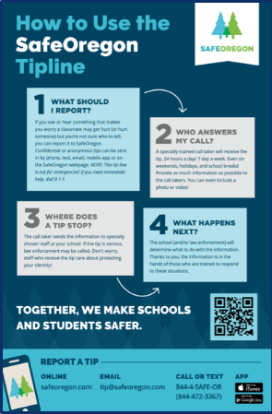
Poster Activity
To advocate for SafeOregon at your school, create a poster to advertise SafeOregon to your classmates.
Your poster should include:
A slogan
'SafeOregon' logo prominently displayed
3-4 tips for how to use SafeOregon
An example of when to use SafeOregon

Slide 22

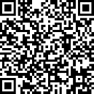

Exit Ticket
Take the Student Survey (four options)
Scan the QR code
On the Web: https://www.surveymonkey.com/r/6T8RMMK
Google Forms: https://forms.gle/gketWKcfYeAy6Va46
Fill out the paper survey
Download the SafeOregon App

